Slide 1




#RintisKarirImpian
Portofolio - Intensive Bootcamp
Introduction to Problem Solving
Owner: (isi nama kamu)

Slide 2

Mini Task
Halojek is a company with 2 main product:
Halofood : a service to provide food delivery
Haloride : a service to provide mobility using motor cycles
The revenue on this quarter (Q3, 23) is decreased for 50% compared to same quarter last year (Q3, 22)

Slide 3
Mini Task (Cont)
The cost for this quarter is as follow:
Marketing cost : IDR 800 Bio,
Labor cost: IDR 750 Bio
Infrastructure cost: IDR 3,500 Bio
The cost for last quarter is as follow:
Marketing cost : IDR 600 Bio,
Labor cost: IDR 600 Bio
Infrastructure cost: IDR 2000 Bio
Objective: Develop problem solving framework for the case above, you are a data analyst to deep dive the root cause of cost increasing on this quarter and also provide the alternative

Slide 4
Step 1: Clarify the Problem
Ideal Condition:
Pendapatan Q3, 2023
125 Bio
Gap:
Pendapatan Q3, 2023
75 Bio
Existing Condition:
Pendapatan Q3, 2023
50 Bio
#RintisKarirImpian

Slide 5
Step 2: Breakdown the Problem
Ideal Condition:
Pendapatan Q3, 2023
125 Bio
HaloRide
30 Bio
Meal Kits
30 Bio
Gap:
Pendapatan Q3, 2023
75 Bio
HaloFood
45 Bio
Grocery Delivery
5 Bio
Existing Condition:
Pendapatan Q3, 2023
50 Bio
UMKM
10 Bio
#RintisKarirImpian

Slide 6
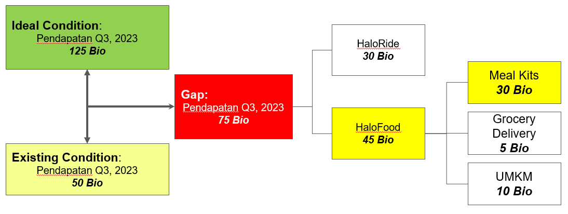
Step 3: Set the Objective
Objective
Tingkatkan pendapatan menjadi 50 Bio untuk Meal Kits melalui peningkatan conversion rate antara Consider to Buy dan Purchase pada Q3, 2024
88%
22%
80%
2700
2400
500
400
Awareness
Consider to Buy
Purchase
Retention
#RintisKarirImpian

Slide 7
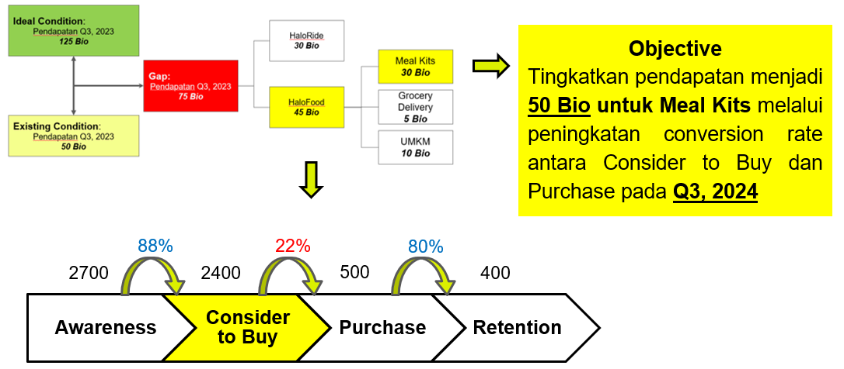
Step 4: Define the root cause
Kenapa terjadi peningkatan biaya?
Promotion
People
Place
Apakah biaya pemasaran meningkat secara signifikan?
Apakah terjadi peningkatan jumlah tenaga kerja atau kenaikan upah?
Apakah ada investasi besar dalam infrastruktur?
Meningkat dari IDR 600 Bio ke IDR 800 Bio
Meningkat dari IDR 600 Bio ke IDR 750 Bio
Meningkat dari IDR 2,000 Bio ke IDR 3,500 Bio
#RintisKarirImpian

Slide 8
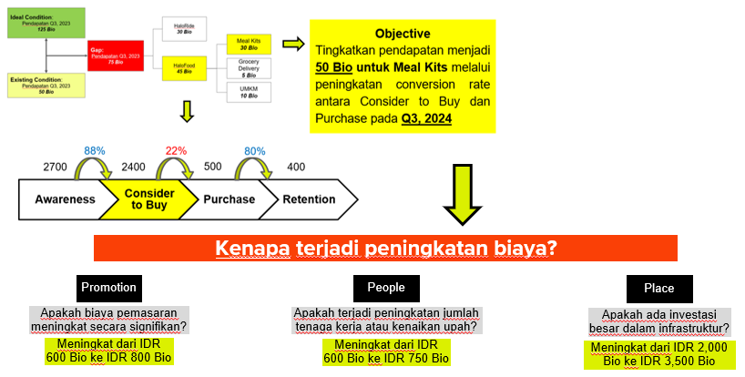
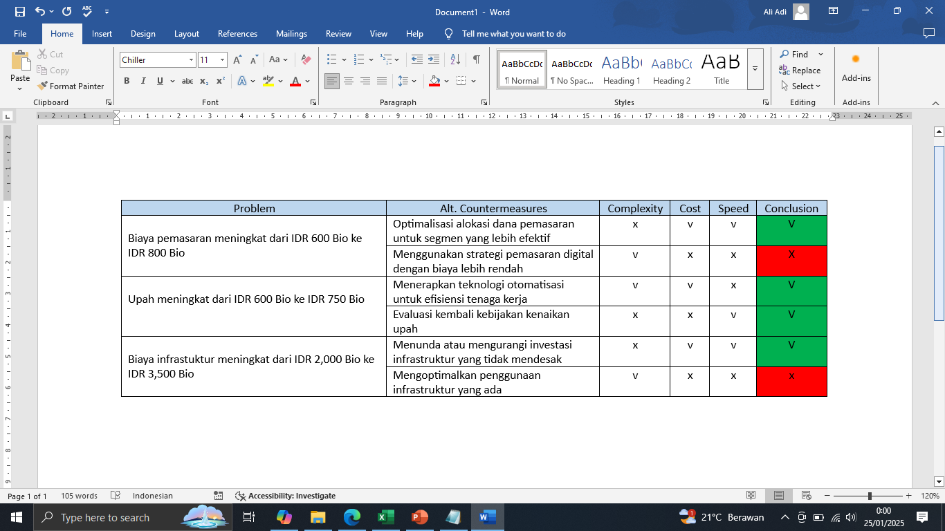
5. Develop Countermeasures
#RintisKarirImpian

Slide 9
Terima Kasih
Build your skill and portfolio via myskill.id/bootcamp
#RintisKarirImpian

